Slide 1
Case Study Group 5
SMIT PANCHAL – B00828070
MEETA CHANCHLANI – B00835734
VIVEK SAKARIYA – B00848519

Slide 2
AGENDA
Data warehousing
ETL
Dataset exploration
Data cleaning
Multi-dimensional Schema Development
Python Script
Business Intelligence
Cognos BI

Slide 3
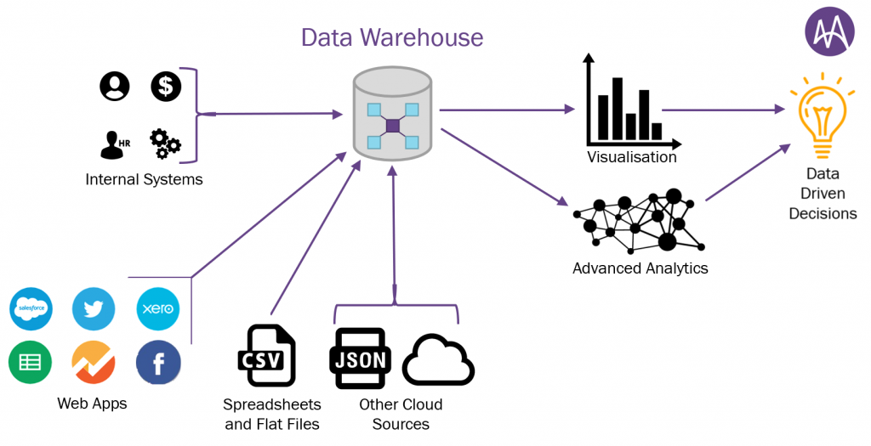
Data Warehousing
It is process of constructing and using a data warehouse.
A data warehouse is constructed by integrating different sources and managing it in a meaningful way.
It generally involves 3 steps such as data cleaning, data integration, and data consolidations.

Slide 4
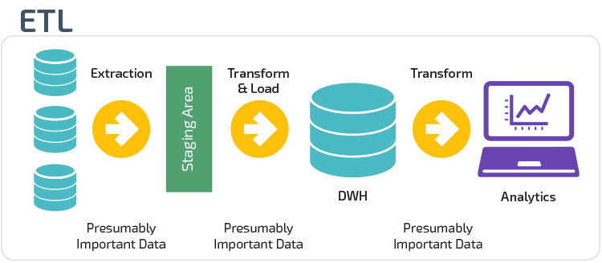
ETL
Extract – collecting data from various sources
Transform – convert the data into understandable form
Load – store the transformed data on the target system

Slide 5
Dataset Exploration
There are 25 fields in the sales_data_sample.csv
The data is related to a specific sales data.
There are various fields which can define the relationships and further be used for visualization.
What is Sales dataset all about?
• The dataset is all about an Automobile Sales.
• It was inspired for retail analytics.
• It was originally written by Maria Carina.
• There are total 25 columns.
• There are total 2823 rows.

Slide 6
General observation of the Data?
• The data is from year 2003 to 2005.
• There are total 109 unique products.
• There are total 19 unique countries.
• There are 92 unique customers.
• There are 307 unique orders.
• There are total 4 territories.

Slide 7
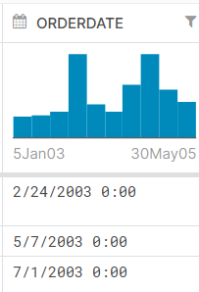
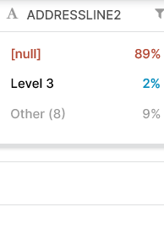
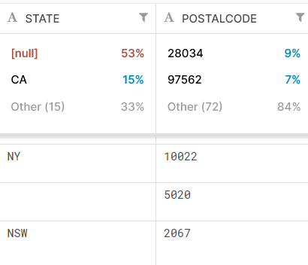
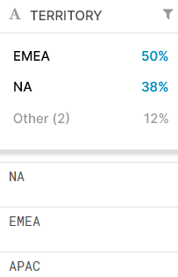
Data Cleaning

Slide 8
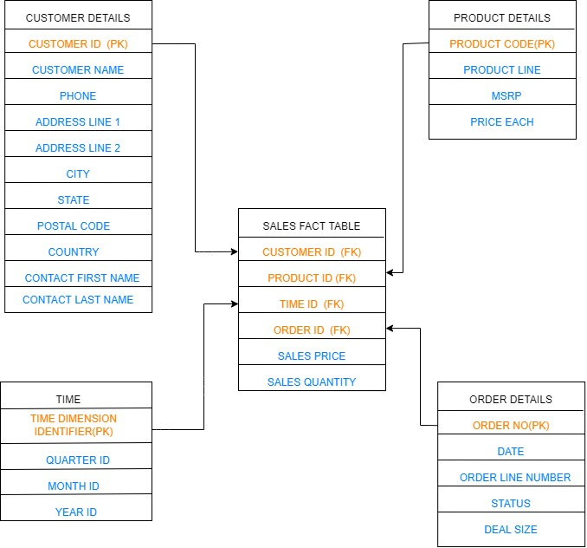
Multi-Dimensional Schema
Initial Schema for design (Star Schema): Option 1

Slide 9
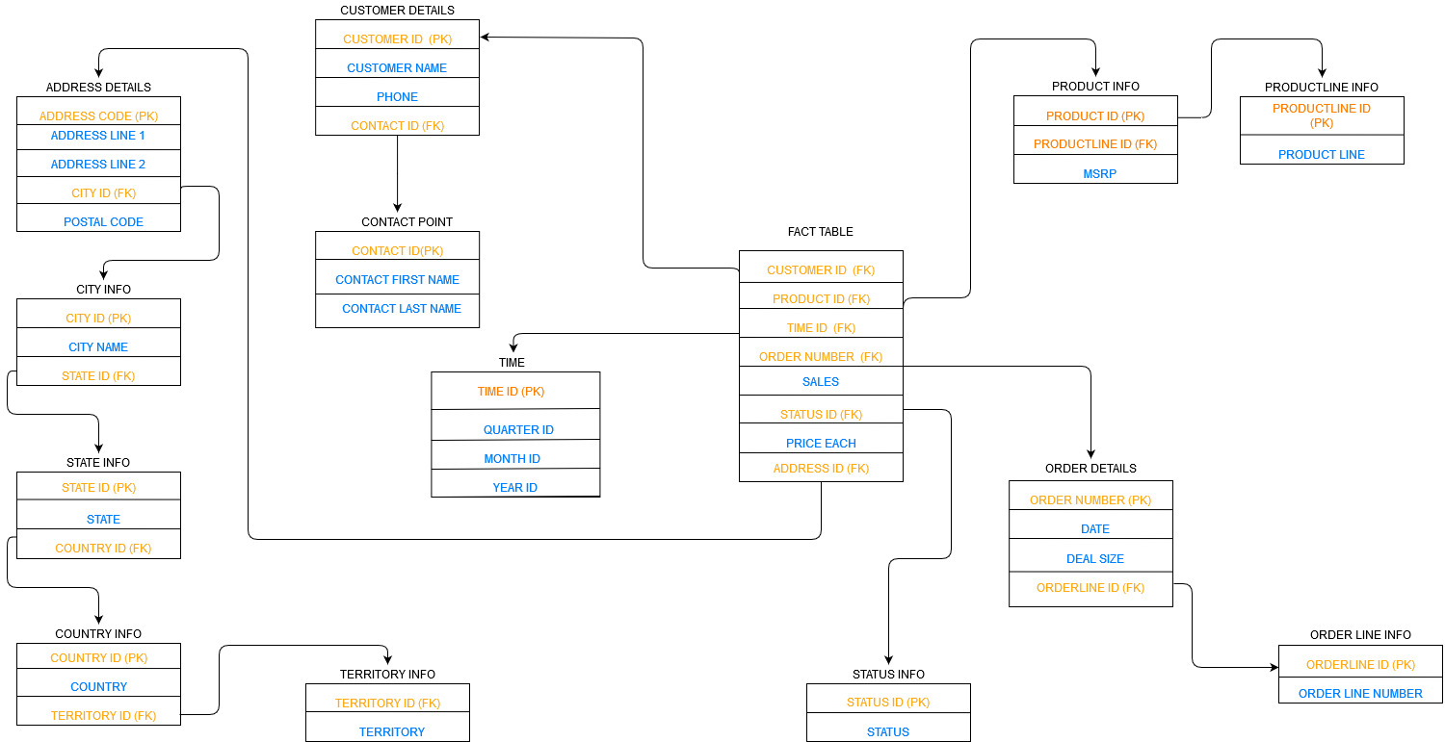
Subsequent Schema (Snowflakes Schema): Option 2

Slide 10

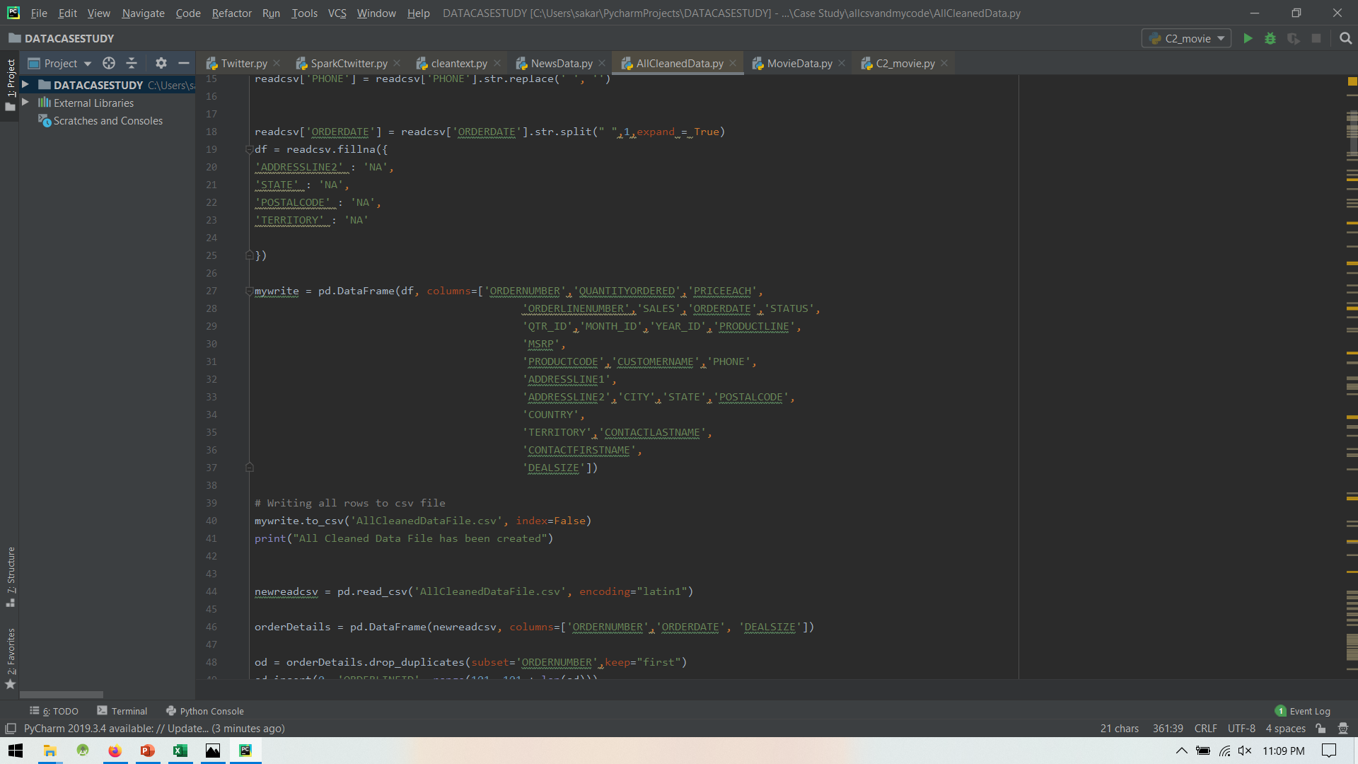
Python Script
Importing pandas library to work with dataframe
Extracting the fields which are needed for making the schema

Slide 11
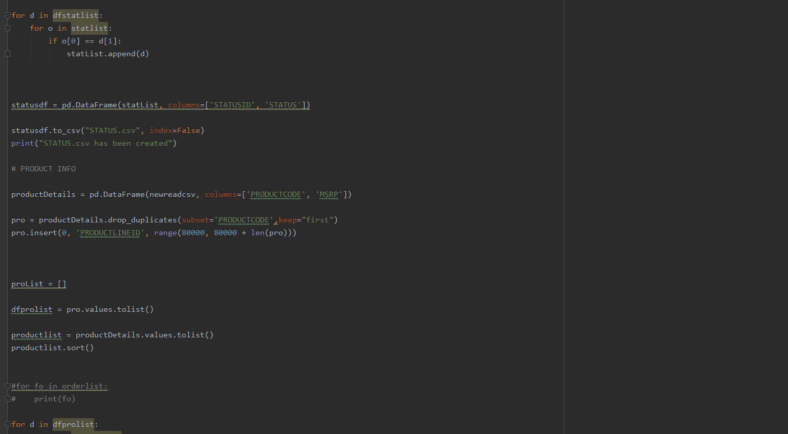
Separation of various dimension tables according to the snowflakes schema

Slide 12
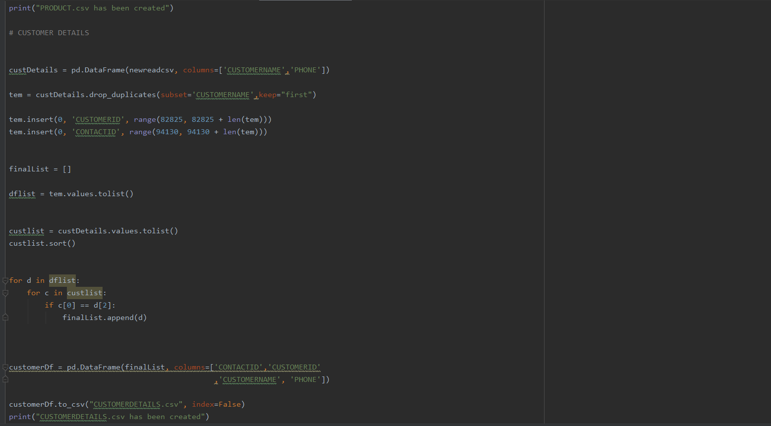
Extracting customer details as a part of dimension table

Slide 13
Business Intelligence
Managers think of the business in terms of business dimensions.
Marketing Vice President
How much did my new product generate?
month by month, in the southern division, by user demographic, relative to the previous version
Marketing Manager
What are the sales statistics?
by products, summarized by product categories, daily, weekly, by distribution channels
Financial Controller
What are the expenses incurred?
Profit/loss

Slide 14
Business Intelligence
It refers to technologies, applications and practices for presenting a business information to collect meaningful information.
The tools used in BI will predict the views of business operations by analyzing the historical information.
It helps to directly load data from the csv or cloud premises.
IBM Cognos Analytics tool:
Cognos Analytics is an AI-fueled business intelligence platform that supports the entire analytics cycle, from discovery to operationalization.
Visualize, analyze and share actionable insights about your data with anyone in your organization.

Slide 15
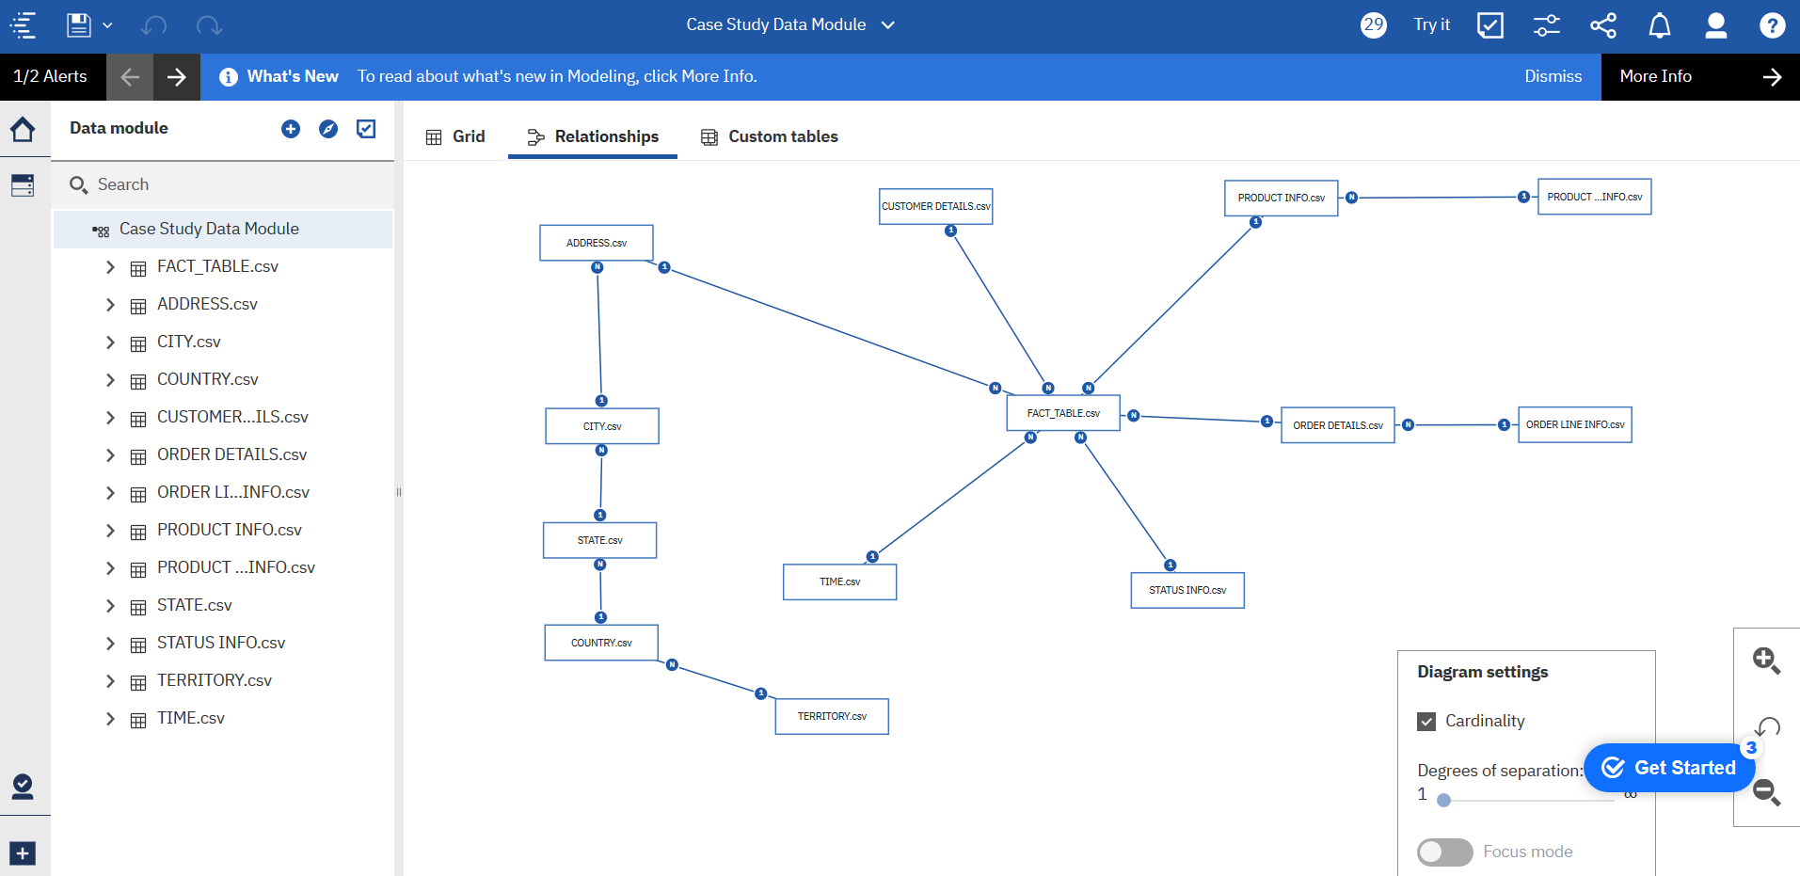

Slide 16
We analyzed data and found insights, which we combined a single dashboard.
There are some insights like:
Product vs Sales data w.r.t Time and Status
Sales vs Quarter w.r.t Time
Sales for customer w.r.t Time
Product vs Sales w.r.t Time and Client
Sales vs Year w.r.t Status

Slide 17
References
https://panoply.io/data-warehouse-guide/3-ways-to-build-an-etl-process/
https://www.minerra.net/business-analytics/what-data-warehouse-how-deliver-value/
https://www.tutorialspoint.com/dwh/dwh_data_warehousing.htm
https://olap.com/learn-bi-olap/olap-bi-definitions/business-intelligence/
https://www.ibm.com/ca-en/products/cognos-analytics
https://books.google.ca/books?id=n2nIM0l1TQ0C&pg=PA91&lpg=PA91&dq=Managers+think+of+the+business+in+terms+of+business+dimensions&source=bl&ots=sUR-HRNUfT&sig=ACfU3U3vaSp-gm-wu18ljwZ2YW9TGffdlg&hl=en&sa=X&ved=2ahUKEwjS99jSk8foAhXTYDUKHejhBlgQ6AEwCXoECA4QLg#v=onepage&q=Managers%20think%20of%20the%20business%20in%20terms%20of%20business%20dimensions&f=false

